Slide 1
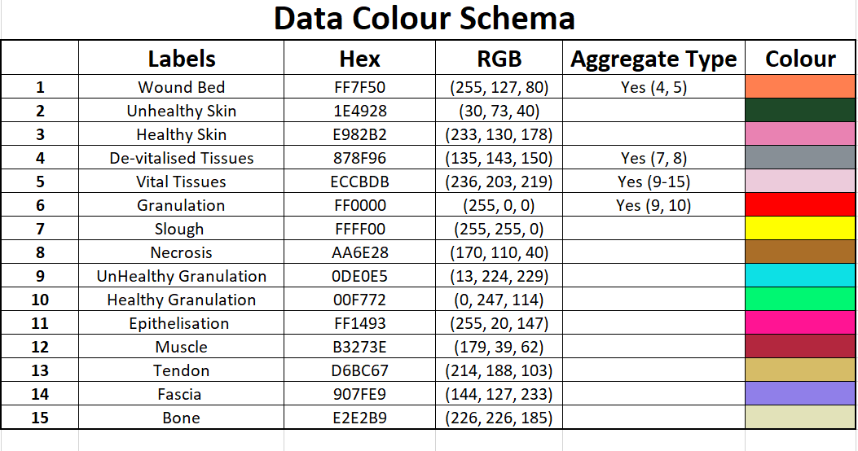

Slide 2
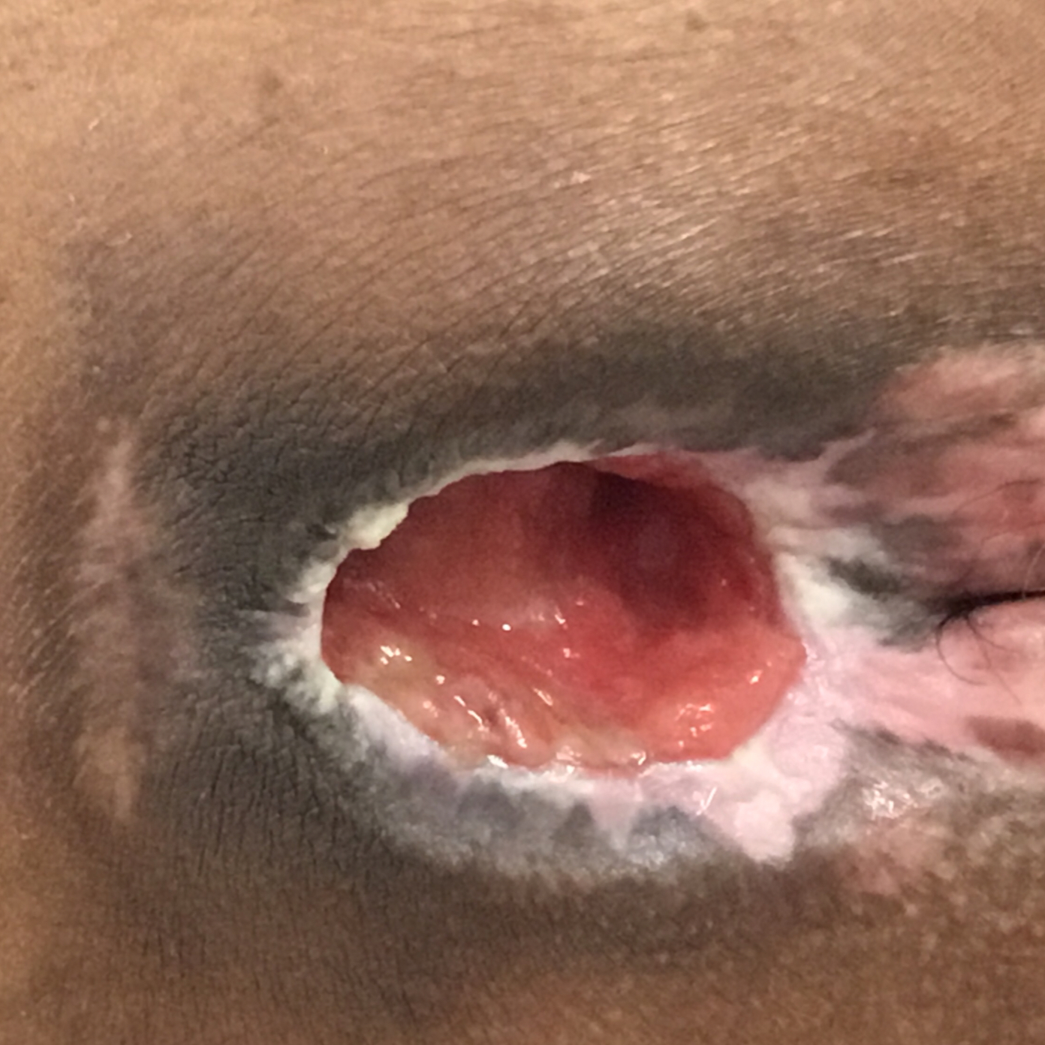
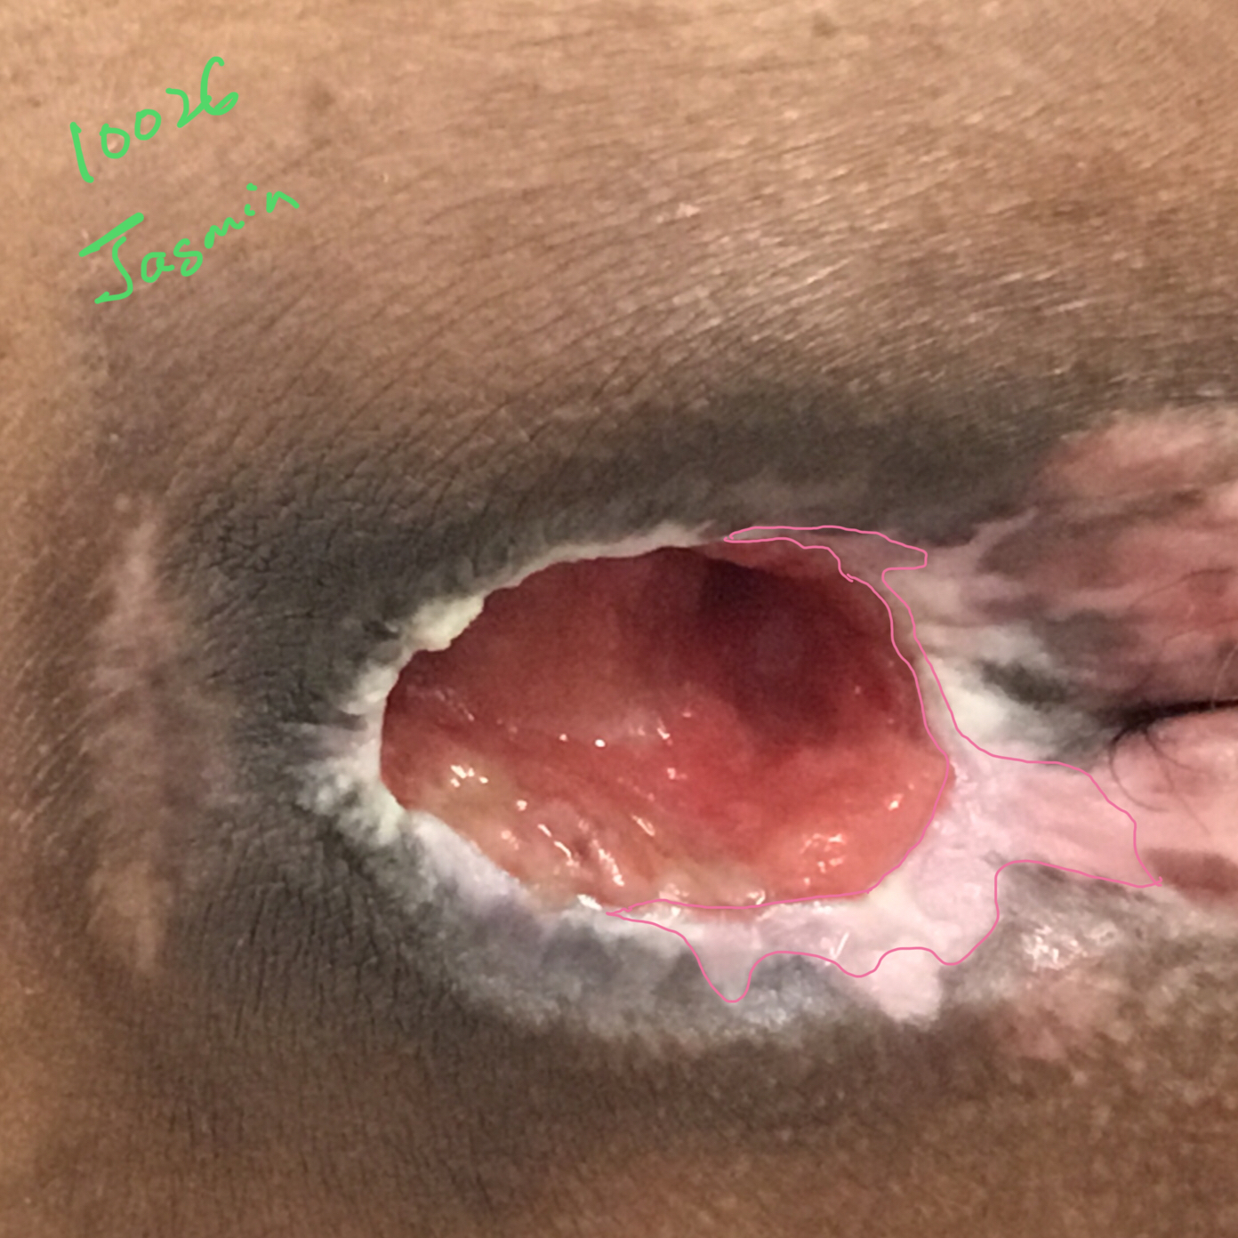

Original Wound Img
Latest Annotation
Original Mask
Metadata Wound Location: Sacral? Wound Type: Pressure Ulcer?

Slide 3
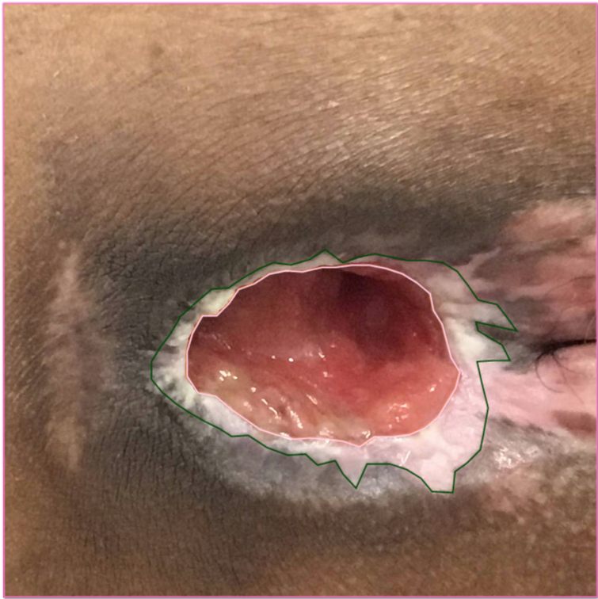
not sure if this area is more unhealthy than healthy
healthy
Notes:
It is healthy.

Slide 4

Original Wound Img
New Mask
Original Mask
SD: Accepted
Notes:
Agreed!!

